Slide 1
Technical Support (420-1N6-AB) Introduction to Linux OS
Fall 2021

Slide 2
Outline
Overview of Linux OS
History of Linux
Linux Architecture
Linux File Structure
The Shell
Navigating the Filesystem

Slide 3
Overview of Linux OS

Slide 4
Overview of Linux != Unix OS
Practical alternative to more costly MS Windows and Apple MacOS operating systems.
Includes:
Graphical desktop
Web browser
E-mail
(Every feature that Windows has to offer – server and desktop)

Slide 5
Software Licensing Agreements
User does not actually own the software.
Only granted a license to use it.
Open source
Software distributed with its source code.
Users can view or modify it.
All Linux versions are open source.

Slide 6
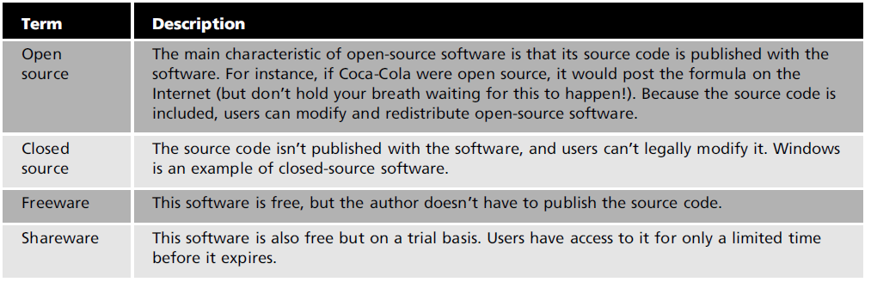
Software Licensing Agreements
Linux kernel licensed under General Public License (GPL).

Slide 7
History of Linux

Slide 8
History of Linux
American Telephone & Telegraph (AT&T)
By 1969, 90% of American homes had AT&T phone service.
Testing and research conducted at Bell Laboratories.
UNIX operating system
Created at Bell Labs by Dennis Ritchie and Ken Thompson.
Many professors began using it for testing and research in university labs.

Slide 9
History of Linux
In early 1980s, AT&T decided to license UNIX and charge institutions a hefty price to use it.
Richard Stallman
Created the GNU (GNU’s Not Unix) Project.
Developed the GPL.
Believed software should be free.

Slide 10
History of Linux
GPL
You can use, view, and change the source code.
You are able to redistribute the software and sell it for a profit.
If you decide to sell the software, you must make the source code available.
MINIX
Created by Andrew Tanenbaum to teach students how to use an OS.
Source code made available to everybody.

Slide 11
History of Linux
Linus Torvalds
Created his own kernel in 1991.
Called the Linux kernel.
Licensed through the GPL.
Many different versions (distributions)
Red Hat (www.redhat.com)
Ubuntu (www.ubuntu.com)
Debian (www.debian.org)
PCLinuxOS (http://pclinuxos.com)
FreeBSD (www.freebsd.org)
openSUSE (www.novell.com/linux)
Kali Linux (Debian) [comes with a shell designed for “ethical” hacking]
Arch

Slide 12
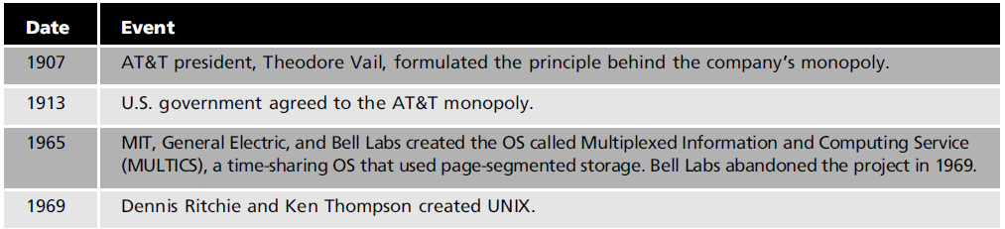
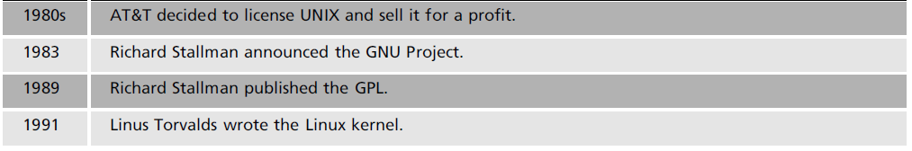
History of Linux

Slide 13
Linux Architecture

Slide 14
Linux Architecture
Modular System
All components are separate from one another.
Makes it possible for different teams to develop components that don’t affect one another.
Linux Distribution
Consists of all the Linux components put together and released as one OS.

Slide 15
Linux Distributions
A typical Linux distribution comprises:
A Linux kernel
GNU tools and libraries
Additional software
Documentation
A window system
A desktop environment (ex. KDE, Gnome)
Most of the included software is free and open-source software made available both as compiled binaries and in source code form, allowing modifications to the original software.

Slide 16
Linux Distributions
Many Linux distributions optionally include some proprietary software that may not be available in source code form, such as binaries required for some device drivers.
Almost all Linux distributions are Unix-like; the most notable exception is Android, which does not include a command-line interface and programs made for typical Linux distributions.

Slide 17
Well-known Linux distributions
Debian: a non-commercial distribution and one of the earliest, maintained by a volunteer developer community with a strong commitment to free software principles
Ubuntu: a popular desktop and server distribution derived from Debian, maintained by British company Canonical Ltd.
Fedora: a community distribution sponsored by American company Red Hat.
Red Hat Enterprise Linux: a derivative of Fedora, maintained and commercially supported by Red Hat
CentOS: a distribution derived from the same sources used by Red Hat, maintained by a dedicated volunteer community of developers maintaining a 100% Red Hat-compatible distro
openSUSE: a community distribution mainly sponsored by German company SUSE.
SUSE Linux Enterprise: derived from openSUSE, maintained and commercially supported by SUSE
Slackware: one of the first Linux distributions, highly Unix-like.

Slide 18
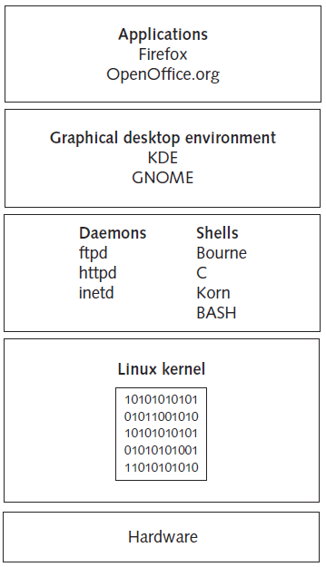
Linux Architecture

Slide 19
Linux Architecture
Kernel
Core of the OS.
Manages hardware, such as disk drives and memory.
Shell
Interface that accepts and translates user input so that the kernel can process it.
Daemons
Programs that run in the background independently of the user
Called services in Windows.

Slide 20
Kernel
Linux kernel
Licensed under the GPL.
Allows public access to the source code.
Resource manager
Manages processes and memory.
Can perform multiple processes at the same time.
Process
Program the kernel launches into memory for the purpose of performing specific tasks.

Slide 21
Linux File Structure

Slide 22
Linux File Structure
Organized in a hierarchical, treelike structure
Top level
Root directory
Indicated with the / symbol
Everything in Linux is considered a file
Device files
“Regular” files.
Directory files.

Slide 23
Linux File Structure
Device file
Special file stored in the /dev directory.
Represents a hardware device on the system.
Regular files
Files containing data.
Directory file
Like a folder in Windows.
Can contain files and other directories.

Slide 24
Features of Linux
Multiuser
Enables multiple users to log on to a single computer at the same time.
Multitasking
Multiple processes can run simultaneously.
Preemptive multitasking
Scheduler decides when a process stops and another process starts based on priority, previous runtime, etc.

Slide 25
Features of Linux
Networking connectivity
Uses Transmission Control Protocol/Internet Protocol (TCP/IP)
Internationally accepted set of rules for connecting computers to the Internet and most other networks.
Security
Login and password authentication.
File ownership and permissions.
Firewall for protecting network resources from users outside the network.

Slide 26
The Shell

Slide 27
The Shell
A shell is a computer program that interprets the commands you type and sends them to the operating system.
Similar to PowerShell under Windows, the Linux shell provides a set of built-in commands and programming control structures, environment variables, etc.
BASH = “Bourne-again Shell” (GNU version of 1977 shell by Stephen Bourne)

Slide 28
Using the Shell
Open the terminal and type
whoami # my login
hostname # name of this computer
echo “Hello, world” # print characters to screen
echo $HOME # print environment variable
echo my login is $(whoami ) # replace $(xx) with program output
date # print current time/date
cal # print this month’s calendar
Commands have three parts;
command, options and parameters.
Example: cal –j 3 2019. “cal” is the command, “-j” is an option (or switch), “3” and “2019” are parameters.
Options have long and short forms. Example:
date –u
date --universal

Slide 29
Command History
Try the history command
Choose from the command history by using the up ↑ and down ↓ arrows
To redo your last command, try !!
To go further back in the command history try !, then the number as shown by history (e.g., !132). Or, !ls, for example, to match the most recent ‘ls’ command.

Slide 30

Help with Commands
Type
date –-help
man date
info date
[And yes, you can always Google it]
For a list of BASH built-in commands, just type the command ‘help’
See also ‘man bash’

Slide 31
Navigating the Filesystem

Slide 32
The Linux File System
The structure resembles an upside-down tree.
Directories (a.k.a. “folders” in Windows) are collections of files and other directories.
Every directory has a parent except for the root directory.
Many directories have subdirectories.
Unlike Windows, with multiple drives and multiple file systems, a Unix/Linux system only has ONE file system.

Slide 33
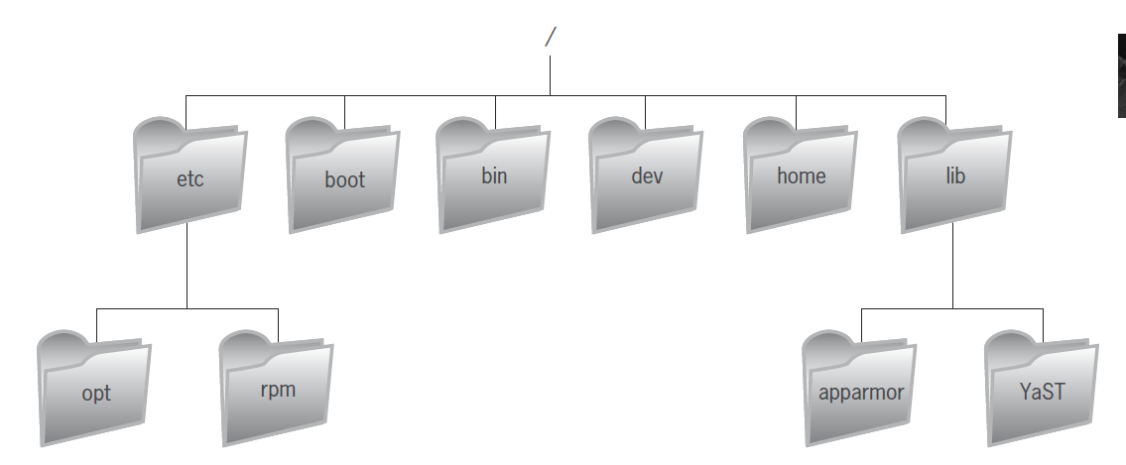
The Linux File System

Slide 34
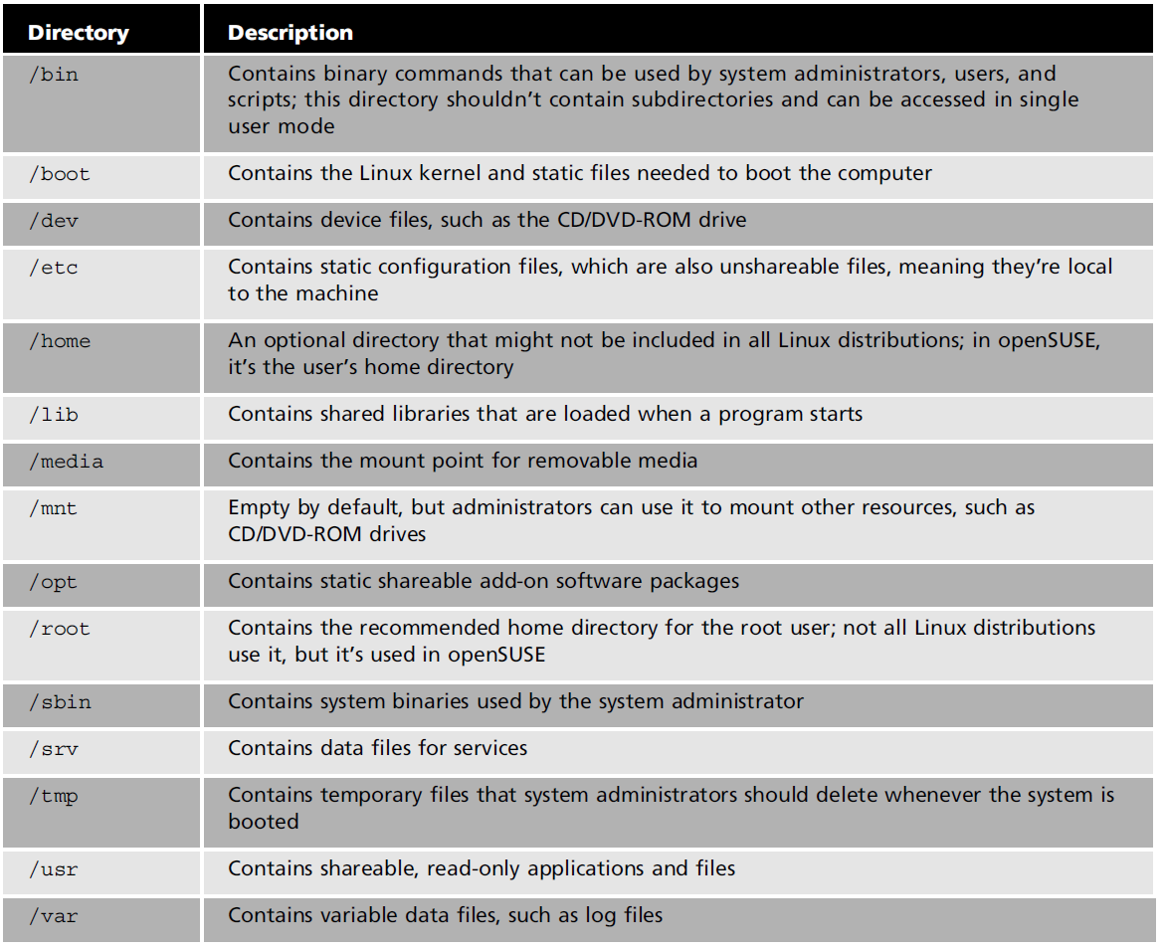
The Linux File System
NOTE: General interest information only, won’t be tested

Slide 35
Navigating the Filesystem
Essential navigation commands:
pwd # print current directory
ls # list files
cd # change directory

Slide 36
Navigating the Filesystem
We use pathnames to refer to files and directories in the Linux file system.
There are two types of pathnames:
Absolute: the full path to a directory or file; begins with /
Relative: a partial path that is relative to the current working directory; does not begin with /
Special characters interpreted by the shell for filename expansion:
~ # your home directory (e.g., /usr1/tutorial/jim1)
. # current directory
.. # parent directory
* # wildcard matching any filename
? # wildcard matching any character
[TAB] # try to complete (partially typed) filename

Slide 37
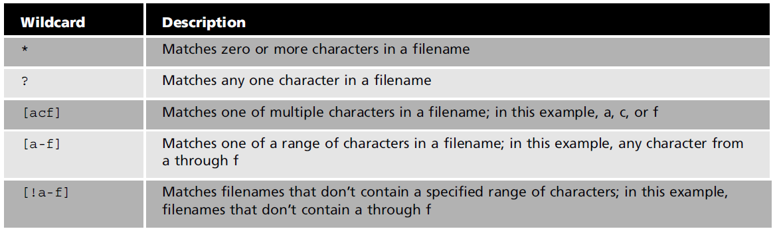
Using Wildcards
Wildcards represent letters and characters used to specify a filename for searches
Linux administrators use wildcards to:
Navigate to directories faster
Move or delete a group of files
Locate files based on a portion of their filenames

Slide 38
Navigating the Filesystem
Examples:
cd /usr/local/lib # change directory to /usr/local/lib
cd ~ # change to home directory (or just type ‘cd’)
pwd # print working (current) directory
cd ..
cd / # (root directory)
ls –d pro* # (a listing of only the directories starting with “pro”)

Slide 39
The ls Command
Useful options for the ls command:
ls -a # List all files, including hidden files (start a “.”)
ls -ld * # List details about a directory and not its contents
ls –l # Simple long listing
ls –lR # Recursive long listing
ls –lh # Give human readable file sizes
ls –lS # Sort files by file size
ls –lt # Sort files by modification time (very useful!)

Slide 40
Some Useful File Commands
cp [file1] [file2] # copy file
mkdir [name] # make directory
rmdir [name] # remove (empty) directory
mv [file] [destination] # move/rename file
rm [file] # remove (-r for recursive)
file [file] # identify file type
less [file] # page through file
head -n [file] # display first n lines
tail -n [file] # display last n lines
ln –s [file] [new] # create symbolic link
cat [file] [file2…] # display file(s)
touch [file] # update modification time

Slide 41
Manipulating Files and Directories
Example:
cd # to your home directory like cd ~
mkdir test
cd test
echo 'Hello everyone' > myfile.txt
echo 'Goodbye all' >> myfile.txt
less myfile.txt
mkdir subdir1/subdir2 # FAILS
mkdir -p subdir1/subdir2 # succeeds
mv myfile.txt subdir1/subdir2
cd ..
rmdir test # FAILS
rm –rf test # succeeds

Slide 42
Q & A
Notes:
In Slide Show mode, click the arrow to enter the PowerPoint Getting Started Center.

